Slide 1
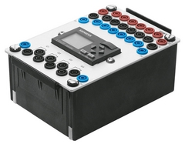


Sistem PLC - TK3434
(Programmable Logic Controler)
Minggu-6 : Electropneumatic Relay
Disusun Oleh :
Simon Siregar, S.Si., MT.
simon.siregar@tass.telkomuniversity.ac.id
Prodi D3 Teknik Komputer
Fakultas Ilmu Terapan
Universitas Telkom
Hanya dipergunakan untuk kepentingan pengajaran di lingkungan Telkom University

Slide 2

Topic Outline:
Electropneumatic Relay
Penggunaan Elektropneumatic Relay dengan DAC

Slide 3
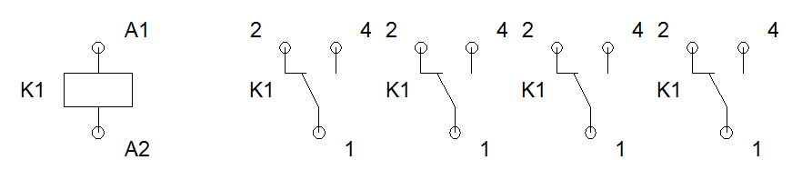
Electropneumatic relay
Relays are electro-magnetically actuated switches. They consist of a housing with electromagnet and movable contacts. An electromagnetic field is created when a voltage is applied to the coil of the electromagnet. This results in attraction of the movable armature to the coil core. The armature actuates the contact assembly. This contact assembly can open or close a specific number of contacts by mechanical means. If the flow of current through the coil is interrupted, a spring returns the armature to its original position.
Notes:
Dosen Menjelaskan :
Apa yang dimaksud dengan Electropneumatic Relay
Fluid Sim
Referensi :
FESTO DIDACTIC, University of Sto.Tomas
Festo Didactic, Pneumatic – Tingkat Dasar P111
Fluid Sim

Slide 4
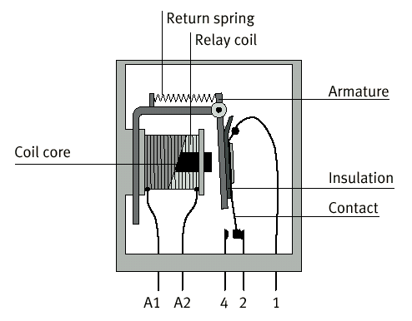
Electropneumatic relay
Notes:
Dosen Menjelaskan :
Apa yang dimaksud dengan Electropneumatic Relay
Fluid Sim
Referensi :
Festo Didactic, Pneumatic – Tingkat Dasar P111
Fluid Sim

Slide 5
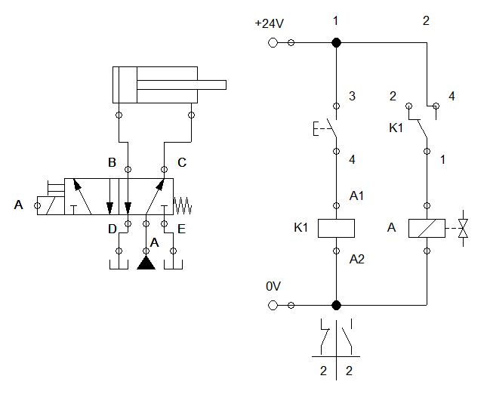
Penggunaan Elektropneumatic Relay dengan DAC
Buat rangkaian seperti gambar disamping.
Item terdapat pada library :
Hydraulic – Supply Element
Hydraulic – Actuator
Hydraulic – Valves – Configurable directional valves
Hydraulic – Valves – Solenoid valves
Electronic Controls – Power Supply
Electronic Controls – Manually Operated
Electronic Controls – General Switches
Electronic Controls – Relays
Catat hasilnya...
Notes:
Dosen Menjelaskan :
Penggunaan Elektropneumatic Relay dengan DAC dalam aplikasi Fluid Sim
Fluid Sim
Referensi :
Festo Didactic, Pneumatic – Tingkat Dasar P111
Fluid Sim

Slide 6
Terima Kasih
Ada pertanyaan?
Next : Latch, Reset, And dan Or

